Slide 1
Review for Exam 1

Slide 2
outline
Exam format
How to prepare
ER diagram (2 quizzes and 1 hw)
Relational model and SQL (1 quiz and 1 project)
Relational algebra (1 quiz)

Slide 3
Format
Open book
Timed (3 hours)
Available from Tuesday 9:30 am to Wednesday 9:30 am, ct
Submission link will disappear after deadline! NO LATE submission
Printing is not necessary
PDF submission. (Accept handwriting! Make sure the picture/scan is clear and readable)
Question format: T/F, multi-choice, drawing, short answer, long answer, etc.

Slide 4
How to prepare
Read slides
Review questions on notes (do it yourself before checking the answers!)
Review quizzes
Review homework
Finish Project 1a (answers will be released after deadline)
Ask/answer questions on Piazza. The discussion can strengthen your understanding

Slide 5
ER diagram
Entity set, relationship set, attribute
Participation constraints
IsA relation

Slide 6
ER diagram
How to read
How to design

Slide 7
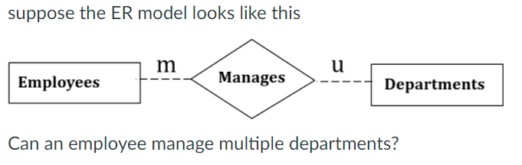
Common problem: Quiz
For an entity, there is only one key attribute.

Slide 8
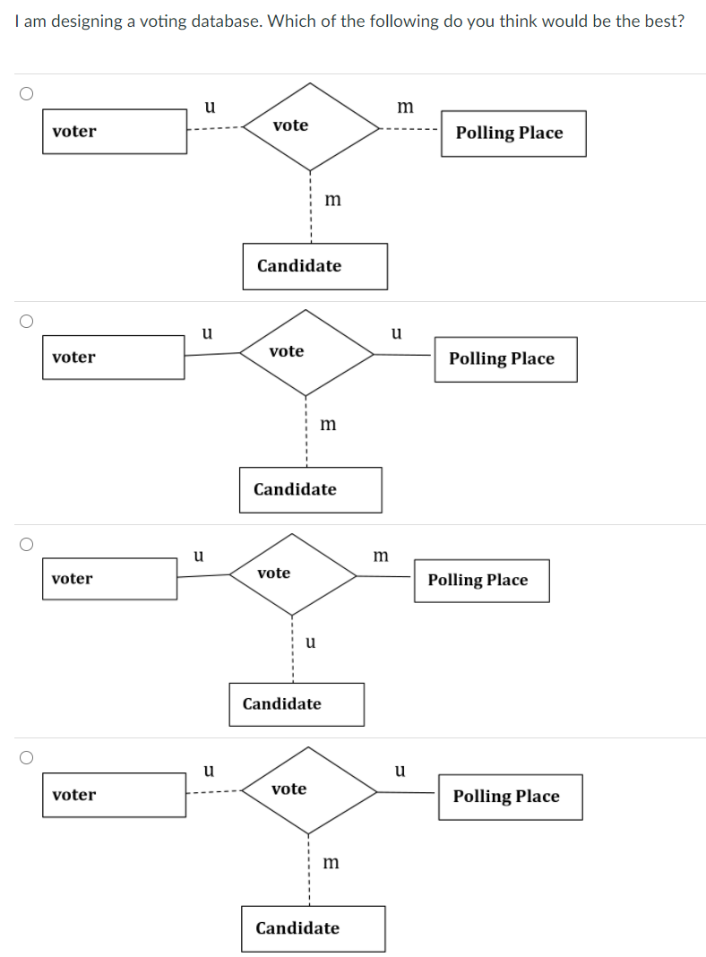
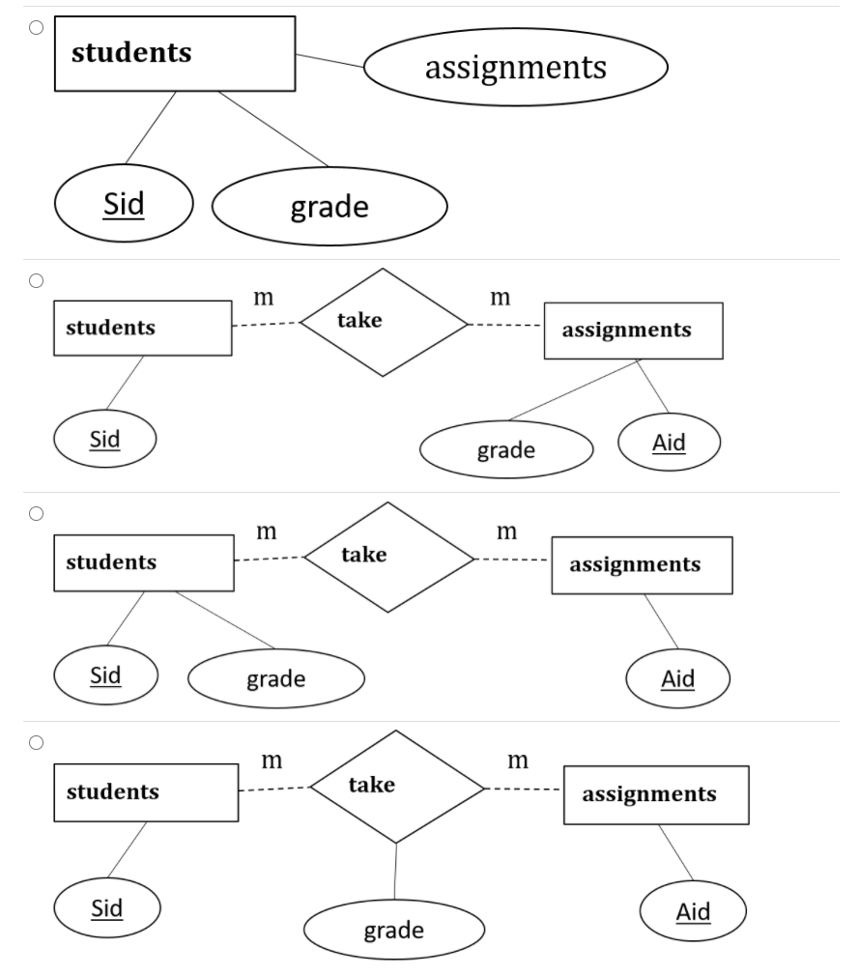

Slide 9
Relational model and SQL
Primary key
Foreign key
How to implement in SQL for a given ER diagram
Query with SQL

Slide 10
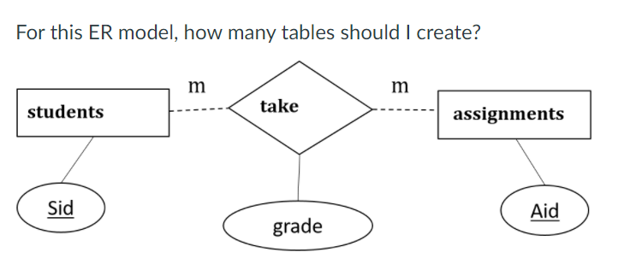
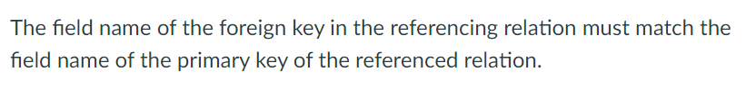



Slide 11
Relational Algebra
Operators
What the results would be?
Given a query in natural language, write/judge the relational algebra expression
Given the relational algebra, write the query in natural language
Given a query in SQL, write the relational algebra
Let’s practice on Class notes

Slide 12
Any Questions?
Slides
Examples in OneNote
Quiz
hw

